Slide 1
Tetris Project Overview and Requirements
-Alex Schexnayder

Slide 2
Project Description
Provide users an easy to use, functional game of Tetris
Will be implemented using a Windows Form Application
The purpose of this project is to emulate the functionality of a traditional Tetris game, while also taking creative liberties with regards to aesthetics, design and small functionality changes. The reason for this is to make a fresh experience for fans of Tetris, while also maintaining the core game mechanics of the original game.

Slide 3
Project Requirements
Application must exhibit easy-to-use interface design for easy user input and functionality
Running score is always accurate regardless of how long the game has been played
No memory issues with tracking scores while in game
The next piece icon is always accurate so gameplay smoothness with the user is never interrupted
Rotation of pieces is accurate and doesn’t disrupt the game flow

Slide 4
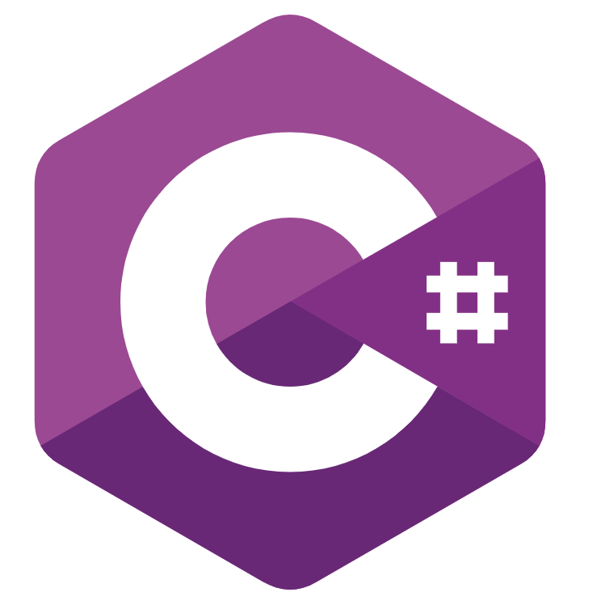

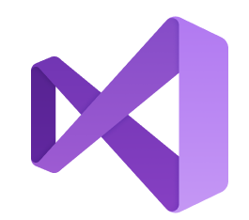

Tools
Languages
Environment
Source Control

Slide 5
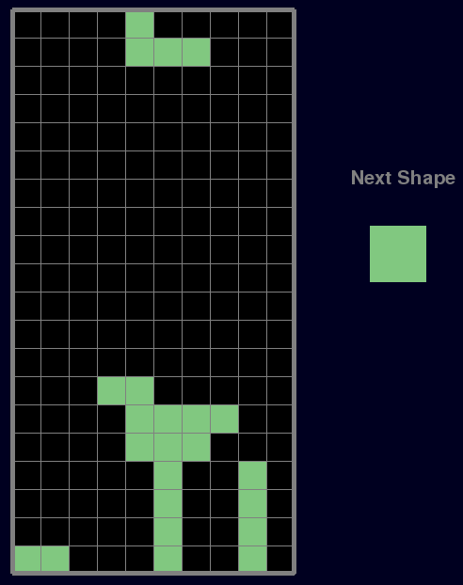
Mockup
Will use different colors for each shape
Will track score

Slide 6
Goals
Main Goals
Program places blocks in exact place user wants every time
“Next” block button accurately shows the correct block every time
Blocks stack correctly
Game ends when appropriate
Stretch Goals
High score tracking
Will need to create game instances to track final score from each game
Log in functionality
Will track multiple different users and their scores from previous games

Slide 7
Development schedule
February
Choose Project
1st Presentation
March
Design Architecture/UML
Finalize minimum functionality
2nd Presentation
April
Testing
Bug Fixes
Possible implementation of stretch goal(s)
May
Final Presentation
Submit Project

Slide 8
Questions?

